Slide 1

Heat
Chapter 29

Slide 2
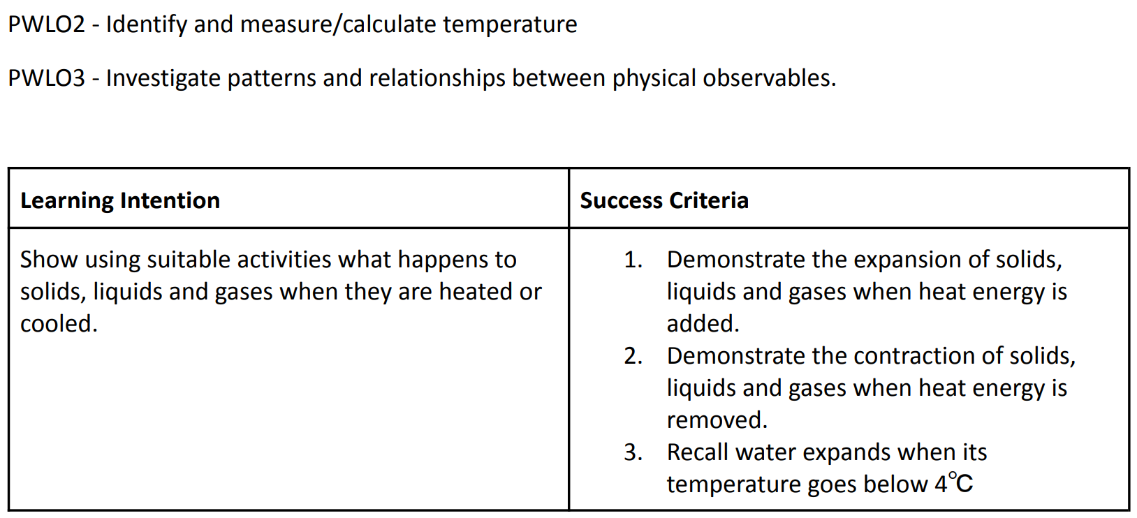
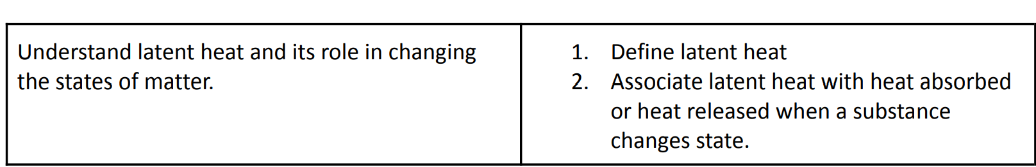

Slide 3

1. Identify what heat is 2. Identify what temperature is 3. The difference between heat and temperature 4. Measure the temperature of various substances

Slide 4
What is heat?
Notes:
take steak from your fridge and throw it on your barbeque, you know that after a little time its temperature will rise. That rise in temperature changes the structure of the meat, cooking it
Heat here is the transfer of energy from the warm BBQ to the cold steak
we know that when an object, like a steak, gets hotter the atoms and molecules that constitute it become more energetic wiggling about a lot. And that’s effectively what temperature is – a measure of how much energetic wiggling about an object is doing.

Slide 5
Is heat a form of energy ?
Notes:
The evidence that heat is a form of energy is that heat can cause movement.
Think of:
Steam engines pulling trains
Curtains moving when they are above a hot radiator

Slide 6
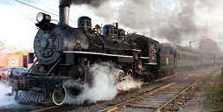
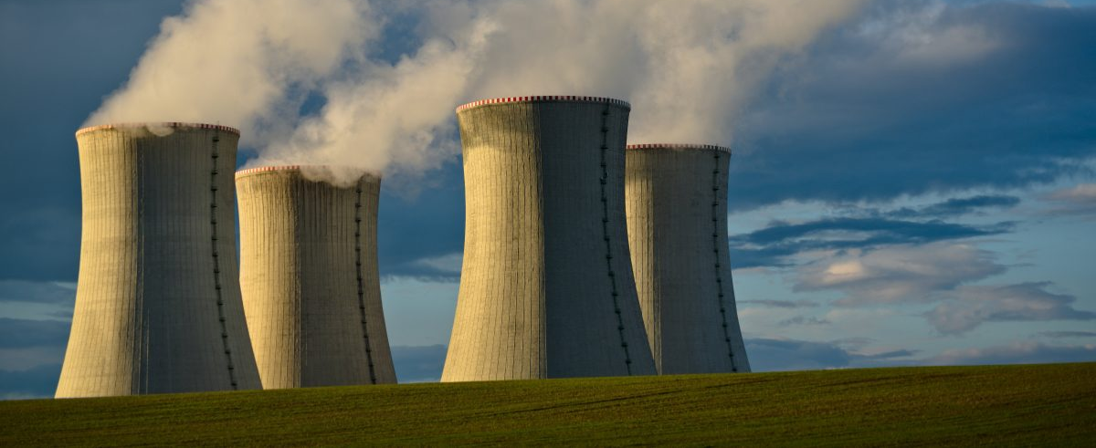
Heat
The transfer of kinetic energy from one medium or object to another, or from an energy source to a object.
Heat is a form of energy.
Heat is measured in joules.
Notes:
As heat is a form of energy it can be converted into other forms. For example, in power stations oil and gas are burned to produce heat energy. This heat produces steam, which turns the blades of a turbine — kinetic energy. This turning of the blades produces electrical energy.
Colder objects dont have as much energy. Their molecules are much less active.

Slide 7
So, when you heat water in a pot, what happens to the energy?
Notes:
f you take a glass of water and your put it in a pot on the cooker, you are heating it by making the water molecules move about more.
kinetic energy increases but the potential energy remains the same.
At a certain point, the water molecules become so energetic that they burst free from one another – we see that as boiling where liquid water changes to steam. The steam could be heated further becoming more and more energetic. Indeed, things can be heated to millions of degrees.

Slide 8
List everyday examples of heat being converted into other forms of energy
Notes:
Heat in the oven
Heat → Electrical energy) Geothermal power (Heat→ Electrical energy) Heat engines, such as the internal combustion engine used in cars, or the steam engine (Heat → Mechanical energy) Ocean thermal power (Heat → Electrical energy)

Slide 9
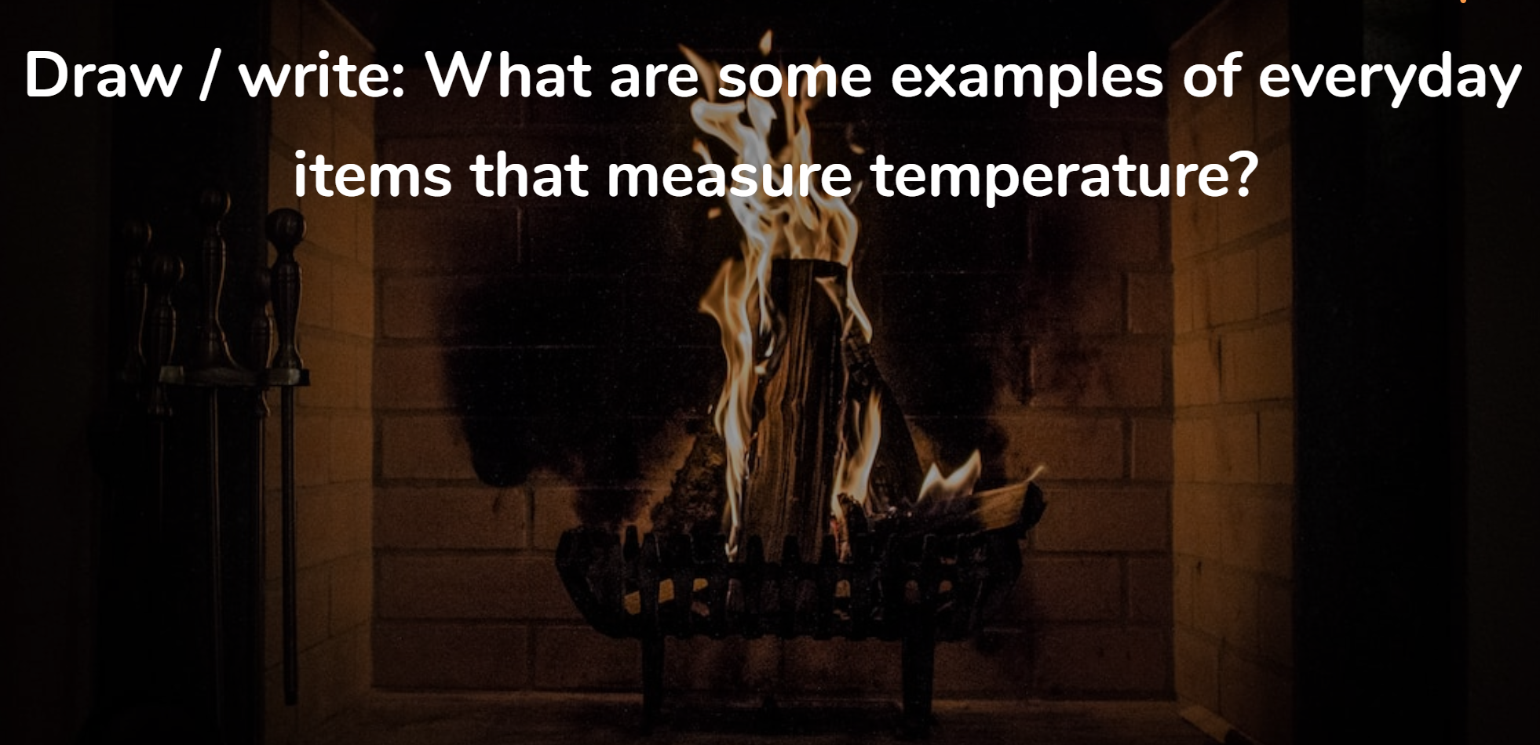
Notes:
The evidence that heat is a form of energy is that heat can cause movement.
Think of:
Steam engines pulling trains
Curtains moving when they are above a hot radiator

Slide 10
What is temperature? And can you describe the differences between heat and temperature
Notes:
take steak from your fridge and throw it on your barbeque, you know that after a little time its temperature will rise. That rise in temperature changes the structure of the meat, cooking it
Heat here is the transfer of energy from the warm BBQ to the cold steak
we know that when an object, like a steak, gets hotter the atoms and molecules that constitute it become more energetic wiggling about a lot. And that’s effectively what temperature is – a measure of how much energetic wiggling about an object is doing.

Slide 11
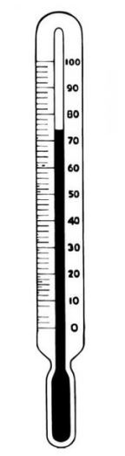
Temperature
Temperature is the degree of hotness or coldness of an object.
Temperature is measured in degrees Celsius (◦ C)
Notes:
When we talk about something feeling hot (like the soup we drink when were sick) or cold (like the snow, especially if youre not wearing gloves), were talking about temperature.

Slide 12

Record the temperature of the following using a thermometer
Substance | Temperature (°C)
Your hand
Water
Hot water
Ice

Slide 13

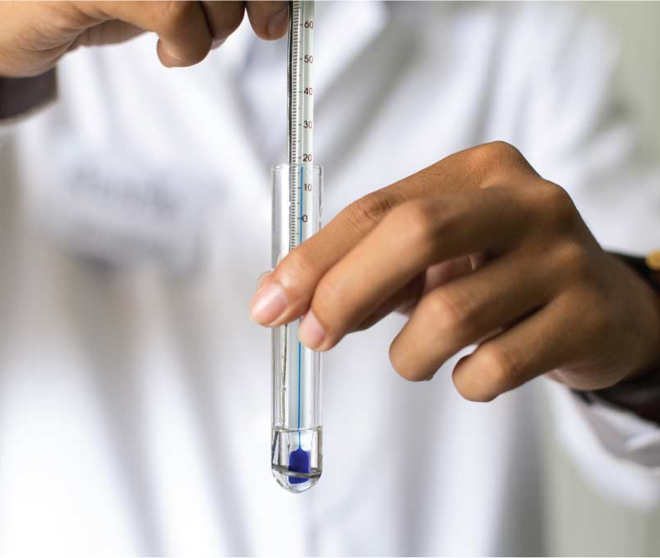
Measuring the temperature of a substance
A thermometer is used to measure temperature.
Electrical thermometer
Laboratory thermometer

Slide 14
Plan a safe experiment to give accurate, reliable results by choosing suitable equipment.
To experiment do solids expand when heated.

Slide 15
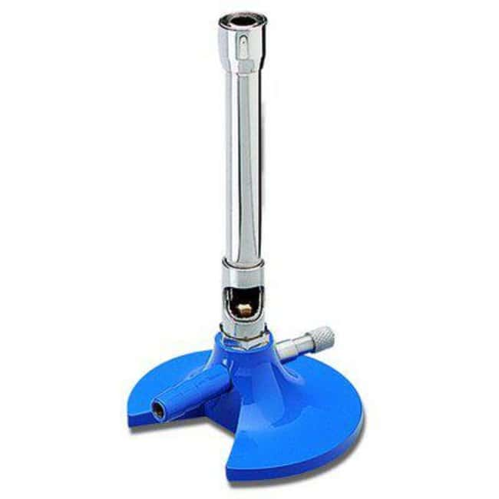
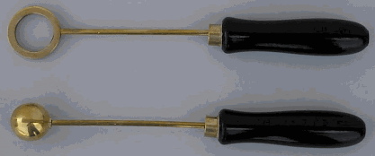
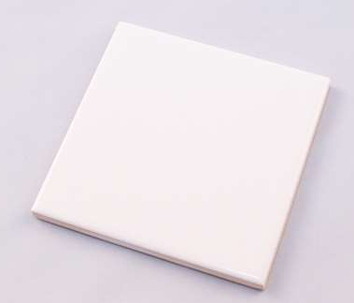
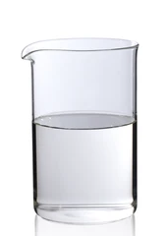
To see what happen to a solid when heated and cooled Equipment
Bunsen burner
Ball & ring
Tile plate
Beaker of water

Slide 16

To see what happens to a solid when heated and cooled. Method :
Check does the ball fit into the ring at room temperature.
Carefully light the Bunsen burner. (orange flame)
Hold the ball over the Bunsen flame for 1- 2 minutes
Try to fit the ball through the ring that is heated.
Cool the ball (cold water).
See if the ball fits through the ring when its cooled.
Note your result.
Notes:
https://www.youtube.com/watch?v=Pm2BvdiZUXA

Slide 17
Questions
In the ball and ring experiment, if the ball after heating is left to cool on the ring for sometime, the ball again passes through the ring. Explain the reason.
How does heating or cooling affect the speed of the molecules and the distance between them?
Notes:
2. Heating speeds up the motion of molecules and cooling slows them down. We’ve also seen that speeding the molecules up makes them move a little further apart and slowing them down allows them to move a little closer together.

Slide 18
https://www.middleschoolchemistry.com/multimedia/chapter1/lesson4#heating_and_cooling_a_solid
Knowing what you do about how solids act when they are heated and cooled, why do you think they put flexible connections in the surface of a bridge?
Notes:
https://www.middleschoolchemistry.com/multimedia/chapter1/lesson4#heating_and_cooling_a_solid
Students should realize that if the bridge is hotter than the land around it, it should be able to expand a bit without breaking. If it is colder than the land around it, it should be able to contract a bit without breaking.

Slide 19

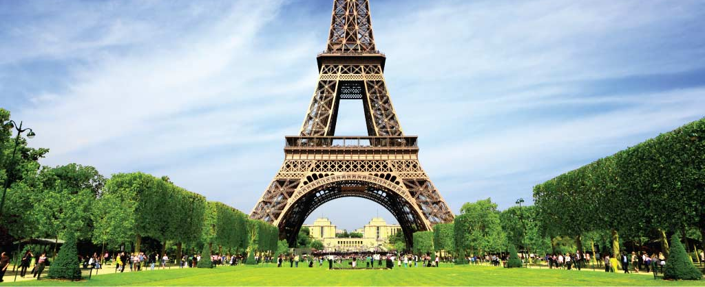
Expansion & contraction
Expand: Increase in volume resulting from an increase in temperature.
Contract: Decrease in volume resulting from an decrease in temperature.
Notes:
The Golden Gate Bridge in San Francisco changes length by over 1 m between winter and summer due to expansion and contraction.
The Eiffel Tower in Paris is 300 m high and is made of iron. Between summer and winter its height changes by as much as 7.5 cm.

Slide 20

Heat transfer
There are three ways in which heat can be moved or transferred:
1. Conduction
2. Convection
3. Radiation
Notes:
https://www.youtube.com/watch?v=Me60Ti0E_rY

Slide 21
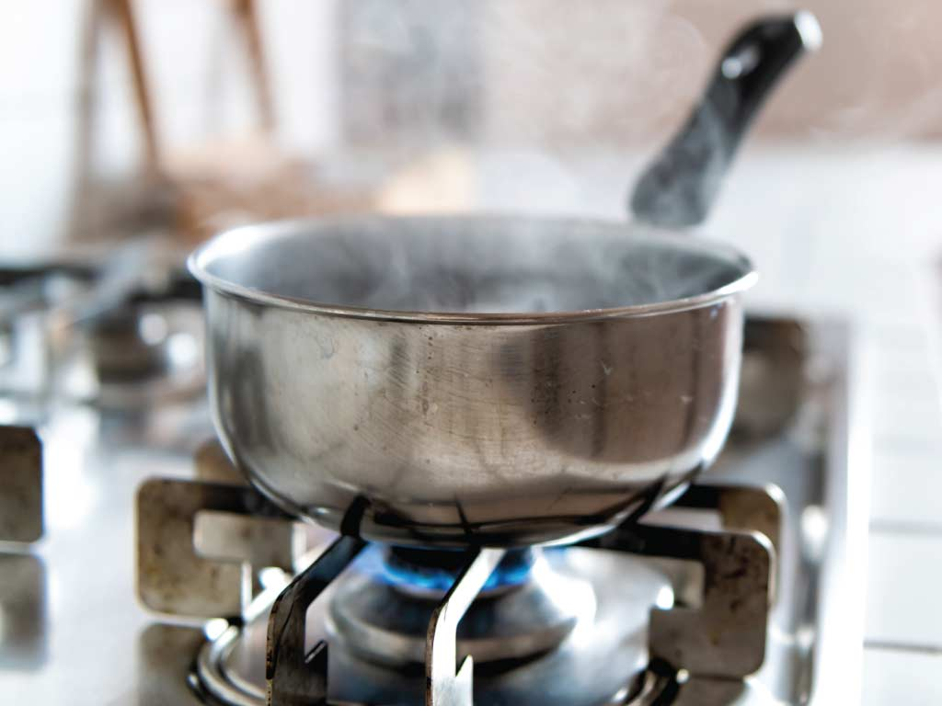
Conduction
The movement of heat energy from one object to another object that is in direct contact and is at a lower temperature
A saucepan on a hob is heated by conduction
Notes:
Works well in solid – metals

Slide 22
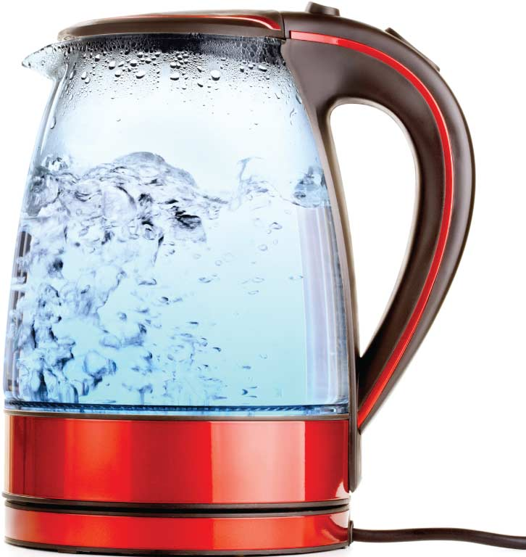
Convection
Convection is the movement of heat energy within a liquid or gas.
Water is heated in a kettle by convection
Notes:
Because particles within a liquid or gas can move, they can transfer the heat within that liquid or gas. This occurs when warmer areas in the liquid or gas rise and are replaced by cooler liquids or gas.

Slide 23
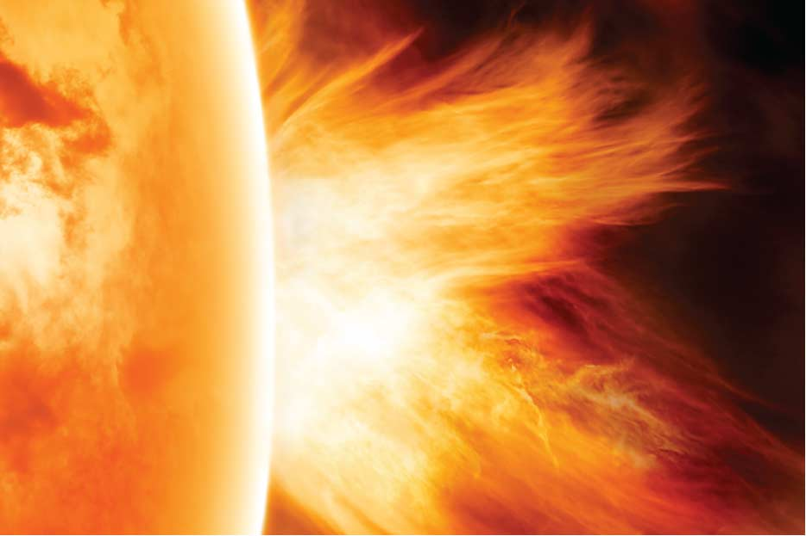
Radiation
The hotter an object is the more heat energy that is emitted or released from the object.
The Sun releases heat energy into space
Notes:
No particles are needed to carry the heat. This form of heat energy (radiation) can move through a vacuum (a vacuum has no particles in it, like space in the solar system).

Slide 24

Give 5 examples of objects that do not transfer heat very well

Slide 25
What name is given to an object that does not conduct heat well?
Notes:
Insulators
What is it called when something doesn't conduct heat?
An insulator is a material that does not allow a transfer of electricity or energy. Materials that are poor thermal conductors can also be described as being good thermal insulators.

Slide 26
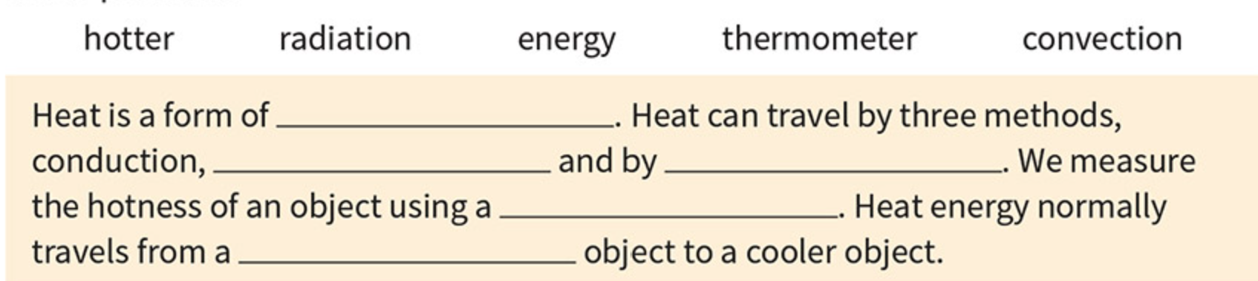
Fill in the blanks

Slide 27
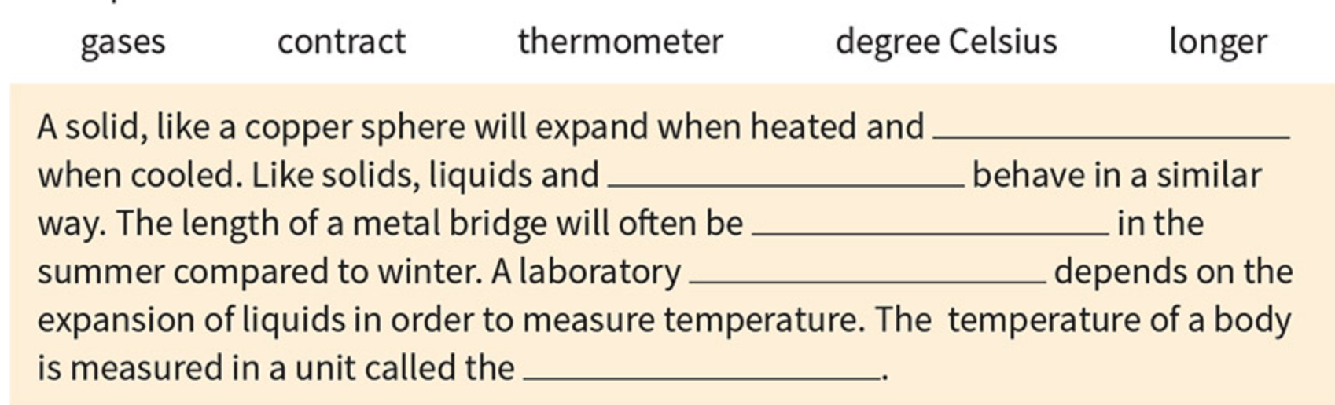
Fill in the blanks

Slide 28
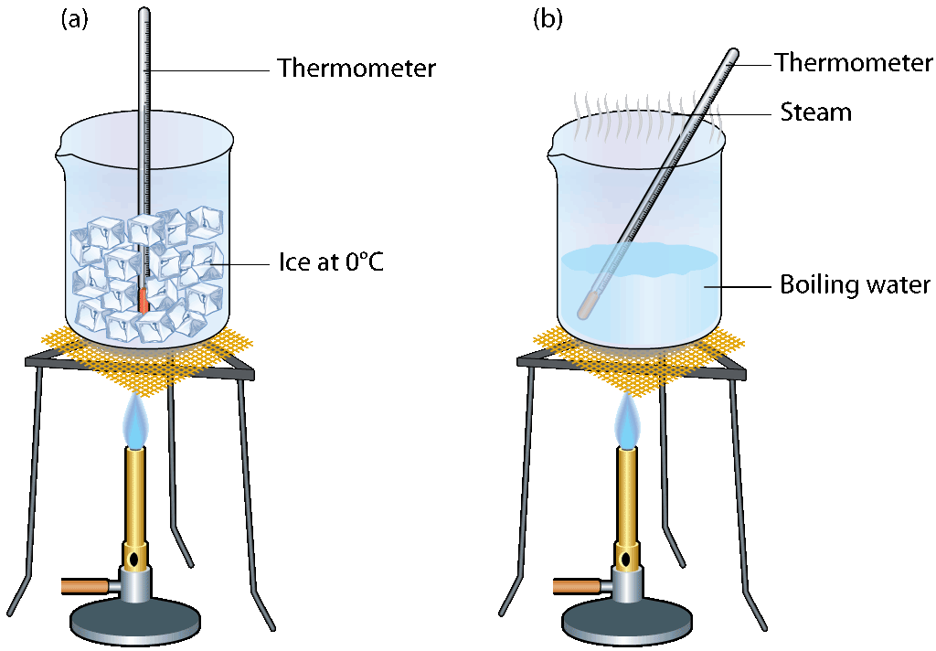
Latent heat
When you heat a beaker of ice you will notice that the temperature does not rise at first.
The temperature remains at 0 °C for several minutes until the last piece of ice has melted.
When you heat a beaker of boiling water you will notice that the temperature does not rise.
The temperature remains at 100 °C

Slide 29
Latent heat
When heat changes a state instead of a temperature we call it latent heat

